Slide 1
Identifying Tweets Under the Influence of Alcohol
Aarthi Shunmugam

Slide 2
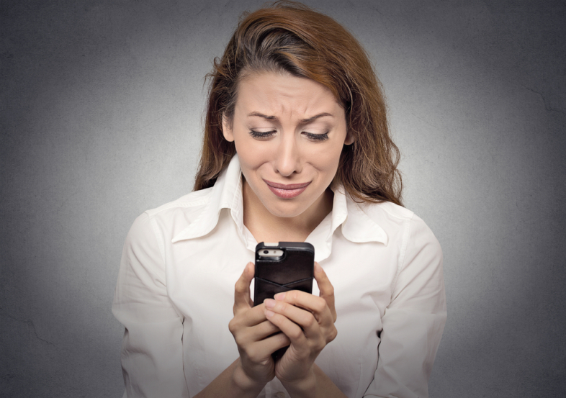

Sending your ex-partner a teary-eyed tweet at 1 a.m. after a bottle of chardonnay isn’t necessarily the best of way of achieving reconciliation. We all know that alcohol and tweeting is not always a good combination.

Slide 3
DATASET
Nabil Hossain and pals at the University of Rochester created a model which uses machine learning algorithm to identify tweets posted under the influence of alcohol.
The team began by collecting geotagged tweets sent during the year up to July 2014 from New York City and from Monroe County on the northern border of the state, which includes the city of Rochester.

Slide 4

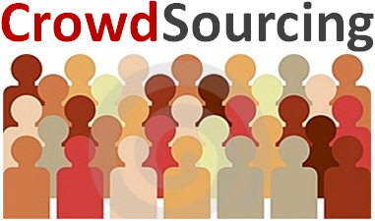
APPROACH
Amazon’s Mechanical Turk crowdsourcing service was used to analyze the tweets in more detail.
The process involves some 11,000 geolocated tweets associated with alcohol to train the model.

Slide 5
ALCOHOL USAGE DETECTION
From the dataset, they filter all the tweets that mention alcohol or alcohol-related words, such as drunk, beer, party, and so on.
Hierarchical classifiers are used as they are easier to optimize because they have a restricted feature set, are less prone to overfitting.
For each SVM, they used 80% of the labeled data for training and the remaining 20% for testing.

Slide 6
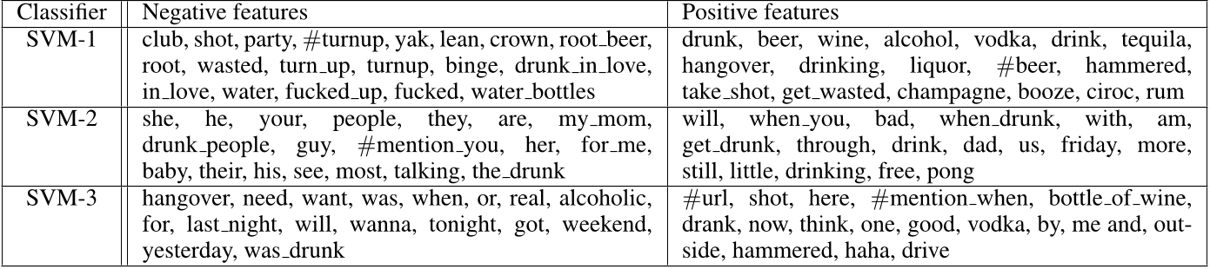
Top weighted features for alcohol classifiers

Slide 7
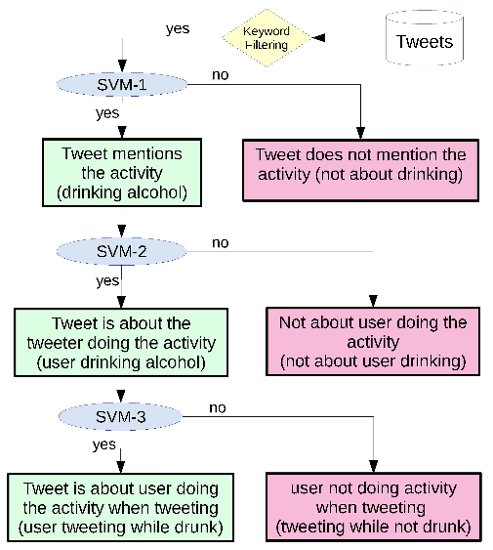
FLOWCHART FOR LATENT ACTIVITY DETECTION

Slide 8
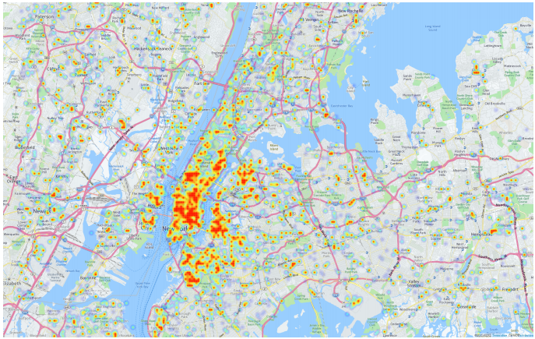
Home Location Prediction
Location of the drunk tweeter can be identified filtering a list of words and phrases people are likely to use in tweets sent from their homes, such as “Finally home!” or bath, sofa, TV, and so on.

Slide 9
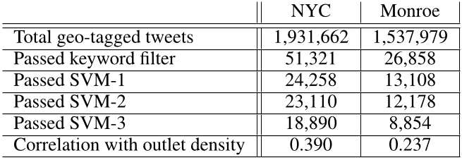
Classification of drinking-related tweets on NYC & Monroe

Slide 10
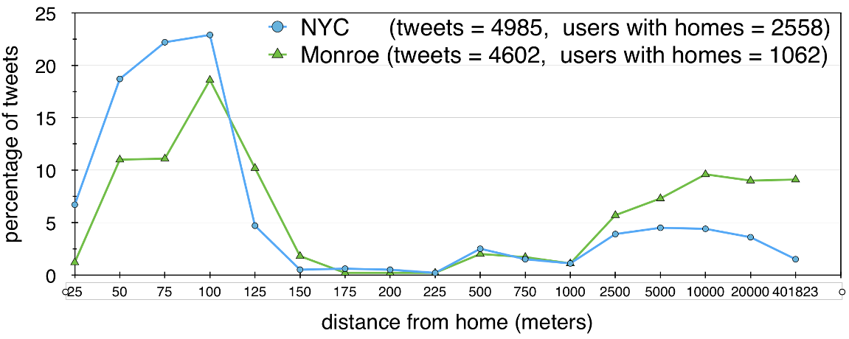
Histogram of distances from home for tweets

Slide 11
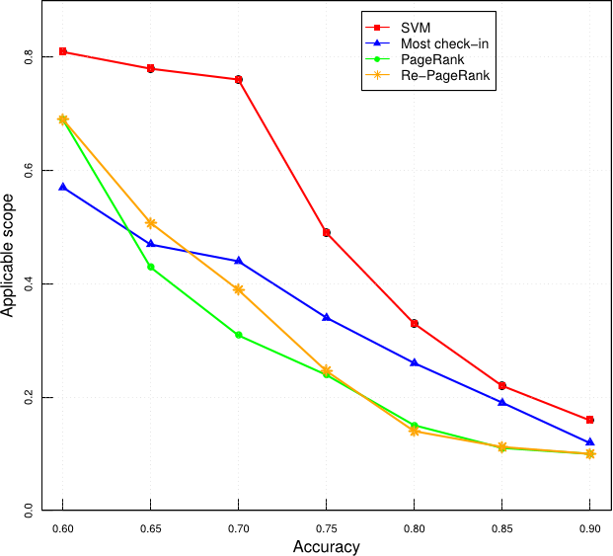
Comparison of SVM method for home location prediction
Tweet was assigned to a cell in 100x100 meter grid. Tweet from a location (grid cell) was called a “check-in”

Slide 12
RESULTS
A higher proportion of tweets in New York City are associated with alcohol than in Monroe County. “One possible explanation is that a crowded city such as NYC with highly dense alcohol outlets and many people socializing is likely to have a higher rate of drinking,”
The geolocation data reveals that a higher proportion of people drink at home (or within 100 meters of home) in New York City than in Monroe County, where a high proportion of people drink further than a kilometer from home.

Slide 13
CONCLUSION
We can use home location identification methods for a range of applications, e.g., analyzing human mobility patterns or studying the relationship between demographics, neighborhood structure, and health conditions. Traditional research on such problems is based on surveys, which are more costly and potentially less timely

Slide 14
Thank You

